Slide 1
Machine Learning Overview

Slide 2
“Google’s self-driving cars and robots get a lot of press, but the company’s real future is in machine learning, the technology that enables computers to get smarter and more personal.
– Eric Schmidt (Google Chairman)
“Over the past decades computers have broadly automated tasks that programmers could describe with clear rules and algorithms. Modern machine learning techniques now allow us to do the same for tasks where describing the precise rules is much harder.”
– Jeff Bezos
“…we also must work on finding diverse ways of utilizing AI. And it’s not just up to the engineers” – Elina Lepomaki
Notes:
AI will revolutionize the world! It will revolutionize healthcare, and it will revolutionize healthcare IT.
All of us need to be thinking about this in our work. The future is now.

Slide 3

What is Machine Learning?
Notes:
Why Machine Learning
You cannot code the rules
You cannot scale
Statistical techniques to use data to learn without being explicitly programmed.

Slide 4
Cerner Intelligence ML Model Lifecycle
Data Collection
Build and Assess Model
Evaluate Results
Deployment
Monitor and Feedback
Business Understanding
Notes:
Business Understanding
Cerner: create scope of capabilities, and review some scaled back version of that with the client to agree on business problem
Client: review business understanding and provide feedback
Data Collection
Cerner: pull data and review data
Client: help in identifying SQL query or data we should pull as needed, help in analyzing the data
Build and Assess Model
Cerner: once we have data, build the model and assess the model accuracy
Evaluate Results
Cerner: share results of model with client
Client: review results of model and provide feedback
Deployment
Cerner: Run model to produce output (silent mode, were we accurate, why did we miss one)
Client: Actively use results of model, client specific tolerances for no show
Monitor and Feedback
Cerner: …
Client: …

Slide 5
2018 Machine Learning Alignment
Intelligence
Workforce Efficiency
Model Experience
Population Health
Operational Transformation
Patient Safety and Quality
Revenue Cycle
Pharmacy Spend
Referral Management
Notes:
How are we prioritizing our work in this area? One of our goals is to ensure we are driving intelligence through our solution portfolio to make Cerner solutions smarter. Working with our clients and internal stakeholders we are initially focused on these areas.
Not necessarily new ideas, but intelligence potentially helps deliver

Slide 6


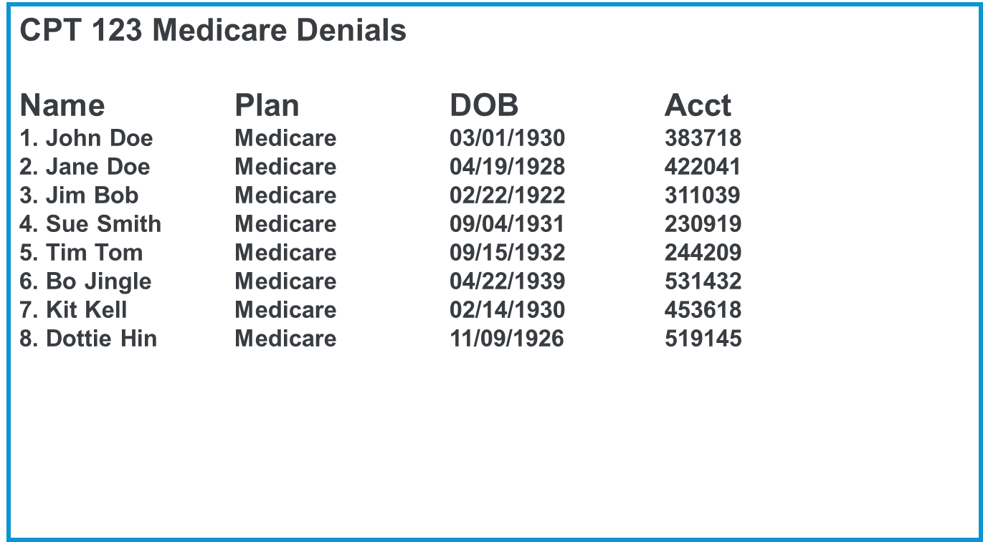
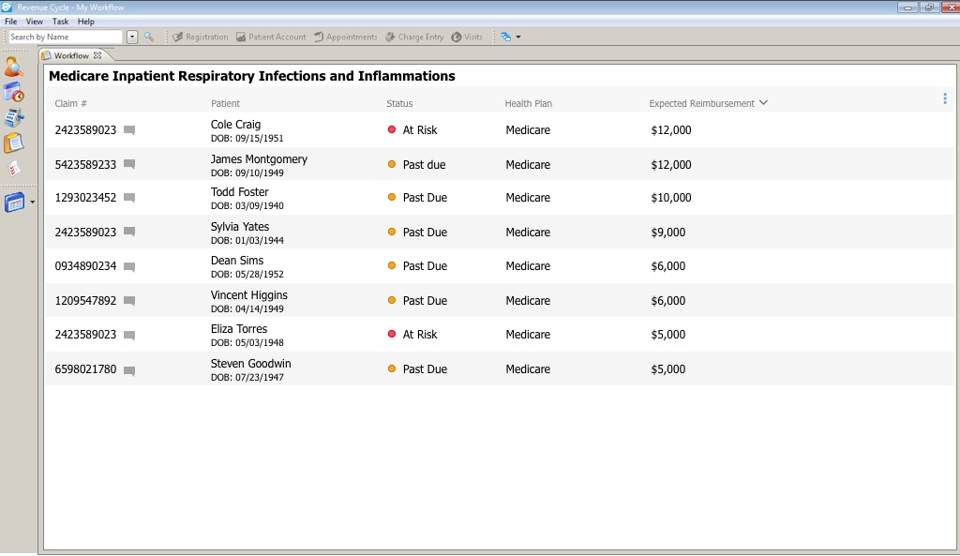
Work Queue Prioritization
Notes:
Solution Vision:
We are creating an intelligent work queue prioritization system that assigns the right work to, to the right person, at the right time, and automates resolution over time.
Prioritization = Risk (how urgent is this)
+ Value (how much will I get paid)
+ Complexity (how hard will this be)
Group similar accounts together to efficiently communicate with the payer and resolve multiple accounts
Assign work to the right person based on person’s history and success with similar claims
Automate resolution based on past successes

Slide 7
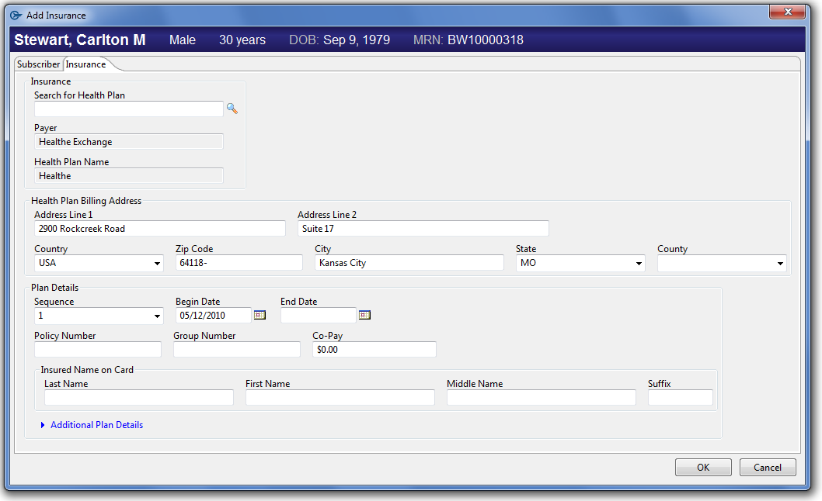
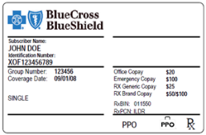
Insurance Card Image Recognition
Health Plan | BlueCross Blue Shield PPO
Policy Number | XOF123456789
Group Number | 123456
Office Co-Pay | $20.00
Coverage Date | 09/01/08
Last Name | Doe
First Name | John

Slide 8
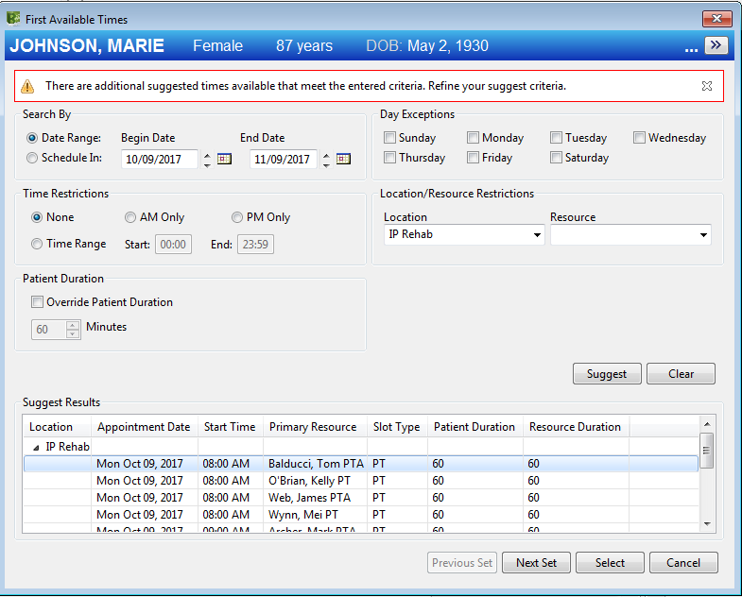
No Show Prediction / Slot Utilization
No Show Worklist
Name | Days | Risk
1. John Doe | 3 | 90%
2. Jane Doe | 5 | 95%
3. Jim Bob | 2 | 65%
4. Sue Smith | 2 | 60%
5. Tim Tom | 4 | 65%
85% No Show Prediction
This patient has missed 4 appointments in the past 1 year.
Patient data predict this patient has a high no show rate for this slot.
Consider an alternate slot. Saturday morning appointments have worked best.
We will send additional text and phone reminders to the patient requesting confirmation of appointment.
No Show Probability
85%
85%
50%
85%

Slide 9
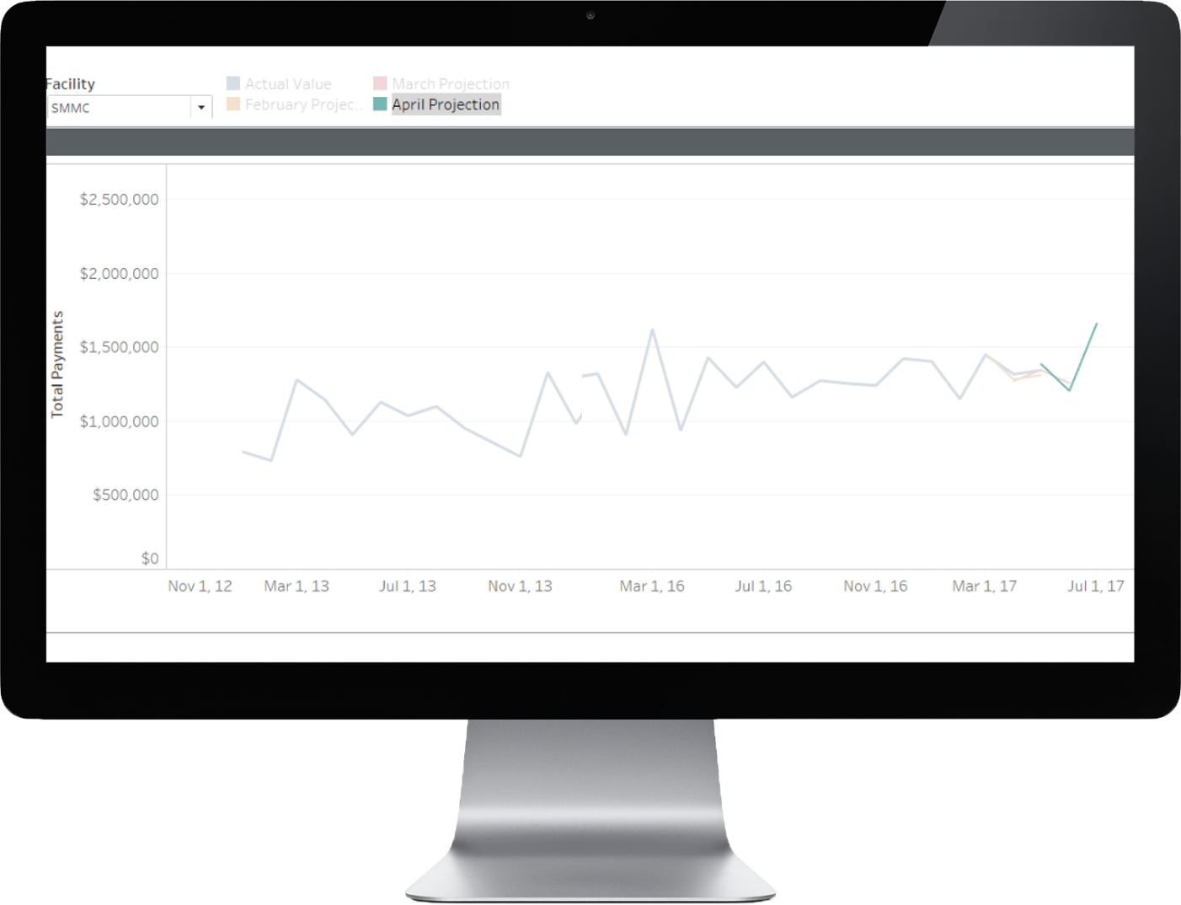
Cash Forecasting

Slide 10
Reality
Data access agreements and approval
Data security
Identifying and pulling data
Deployment

Slide 11
Machine Learning Projects and Demo

Slide 12
Recent HIM Machine Learning Use Cases
Use Cases | Why | Future
Diagnosis and Procedures Sequencing | HIM Coding Efficiency HIM Coding Errors | Automated Coding
Rules Based Coding Suggestions | HIM Coding Efficiency HIM Coding Errors | Automated Coding
Predict DRG | Resources in Facilities HIM Coding Errors | Better Planning for Facilities

Slide 13
Diagnosis / Procedures Sequencing: Results
Diagnosis Sequencing | Confidence
V5481 V5789 | 89%
3963 4241 4280 | 90%
25060 2724 4111 41401 | 89%
Procedure Sequencing | Confidence
7220 8102 | 92%
41401 41402 66 | 94%
2720 4139 66 | 90%

Slide 14
Predict DRG: Hierarchical DRG Grouping
DRG Grouper
Machine Learning Model
MDC Assignment
(1 to 25)
Inputs
Predicted MDC
MDC 1
MDC 2
MDC 3
. . . . . . . . . .
MDC 25
Machine Learning Model
Predicted DRG for MDC 1
Machine Learning Model
Predicted DRG for MDC 25
Inputs for MDC 1
Inputs for MDC 3
Machine Learning Model
Predicted DRG for MDC 3
Inputs for MDC 25

Slide 15
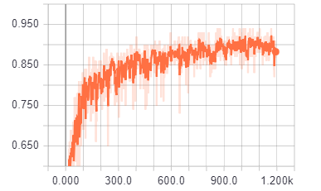
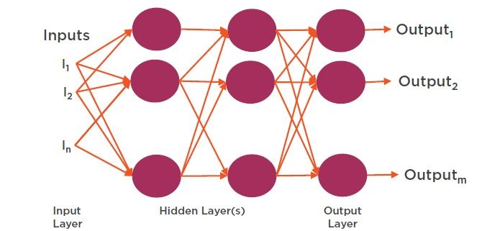
Predict DRG: Results
Predict MDC
Predict DRG from each MDC
Model | Test Accuracy | Precision | Recall
Decision Tree | 92% | 91% | 91%
Random Forest | 91% | 91% | 90%
Naive Bayes | 59% | 58% | 58%
Ada-Boost Classifier | 91% | 91% | 90%
XgBoost Classifier | 76% | 77% | 75%
Accuracy
Iterations
Neural Net

Slide 16
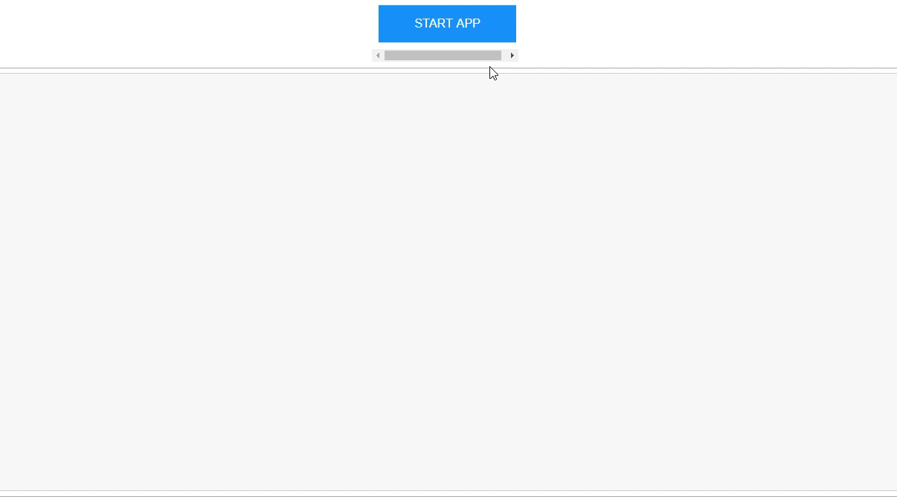
Predict DRG: DEMO

Slide 17
Questions

